Slide 1
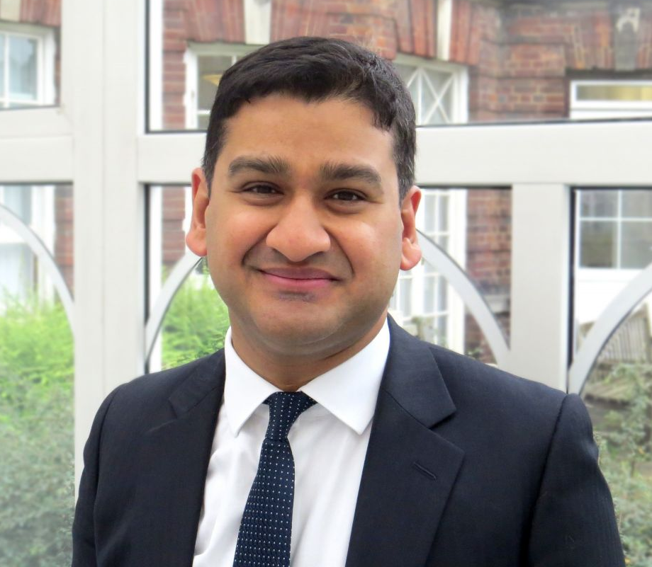
EXAMPLE TEMPLATE – PLEASE EDIT FOR YOUR TALK
3-6 OCTOBER 2021
Connect with us
Heart Rhythm Congress
@heartrhythmcong
Dr Shouvik Haldar
Consultant Cardiologist & Electrophysiologist
Royal Brompton & Harefield NHS Foundation Trust
Presentation Title​
<Insert here>
Dr Shouvik Haldar is a Consultant Cardiologist & Electrophysiologist at the Royal Brompton & Harefield NHS Foundation Trust. He graduated from Guy’s and St Thomas’s Medical School, trained in NW Thames Cardiology Training Programme and completed his subspecialty training at the Royal Brompton & Harefield NHS Foundation Trust and the University of Toronto. He has a strong research record, publishing many peer reviewed articles, and is an invited speaker at international conferences and meetings in the US and Europe. Dr Haldar is passionate about medical education and is currently Chair of Education at the British Cardiovascular Society.
www.heartrhythmcongress.org
01789867524 • info@heartrhythmcongress.org.uk
Arrhythmia Alliance registered charity number 1107496 ​

Slide 2
3-6 OCTOBER 2021
First class education from global arrhythmia experts
Connect with us
Heart Rhythm Congress
@heartrhythmcong
Conflict of Interest
Please ensure you complete the conflict of interest slide,
if there are none please state this on the slide.
www.heartrhythmcongress.org
01789867524 • info@heartrhythmcongress.org.uk
Arrhythmia Alliance registered charity number 1107496 ​

Slide 3
3-6 OCTOBER 2021
First class education from global arrhythmia experts
Connect with us
Heart Rhythm Congress
@heartrhythmcong
www.heartrhythmcongress.org
01789867524 • info@heartrhythmcongress.org.uk
Arrhythmia Alliance registered charity number 1107496 ​

Slide 4
3-6 OCTOBER 2021
First class education from global arrhythmia experts
Connect with us
Heart Rhythm Congress
@heartrhythmcong
www.heartrhythmcongress.org
01789867524 • info@heartrhythmcongress.org.uk
Arrhythmia Alliance registered charity number 1107496 ​

Slide 5
3-6 OCTOBER 2021
First class education from global arrhythmia experts
Connect with us
Heart Rhythm Congress
@heartrhythmcong
www.heartrhythmcongress.org
01789867524 • info@heartrhythmcongress.org.uk
Arrhythmia Alliance registered charity number 1107496 ​

Slide 6
3-6 OCTOBER 2021
First class education from global arrhythmia experts
Connect with us
Heart Rhythm Congress
@heartrhythmcong
www.heartrhythmcongress.org
01789867524 • info@heartrhythmcongress.org.uk
Arrhythmia Alliance registered charity number 1107496 ​

Slide 7
3-6 OCTOBER 2021
First class education from global arrhythmia experts
Connect with us
Heart Rhythm Congress
@heartrhythmcong
www.heartrhythmcongress.org
01789867524 • info@heartrhythmcongress.org.uk
Arrhythmia Alliance registered charity number 1107496 ​

Slide 8
3-6 OCTOBER 2021
First class education from global arrhythmia experts
Connect with us
Heart Rhythm Congress
@heartrhythmcong
www.heartrhythmcongress.org
01789867524 • info@heartrhythmcongress.org.uk
Arrhythmia Alliance registered charity number 1107496 ​

Slide 9
3-6 OCTOBER 2021
First class education from global arrhythmia experts
Connect with us
Heart Rhythm Congress
@heartrhythmcong
www.heartrhythmcongress.org
01789867524 • info@heartrhythmcongress.org.uk
Arrhythmia Alliance registered charity number 1107496 ​

Slide 10
3-6 OCTOBER 2021
First class education from global arrhythmia experts
Connect with us
Heart Rhythm Congress
@heartrhythmcong
www.heartrhythmcongress.org
01789867524 • info@heartrhythmcongress.org.uk
Arrhythmia Alliance registered charity number 1107496 ​

Slide 11
3-6 OCTOBER 2021
First class education from global arrhythmia experts
Connect with us
Heart Rhythm Congress
@heartrhythmcong
www.heartrhythmcongress.org
01789867524 • info@heartrhythmcongress.org.uk
Arrhythmia Alliance registered charity number 1107496 ​

Slide 12
3-6 OCTOBER 2021
First class education from global arrhythmia experts
Connect with us
Heart Rhythm Congress
@heartrhythmcong
www.heartrhythmcongress.org
01789867524 • info@heartrhythmcongress.org.uk
Arrhythmia Alliance registered charity number 1107496 ​

Slide 13
3-6 OCTOBER 2021
First class education from global arrhythmia experts
Connect with us
Heart Rhythm Congress
@heartrhythmcong
www.heartrhythmcongress.org
01789867524 • info@heartrhythmcongress.org.uk
Arrhythmia Alliance registered charity number 1107496 ​

Slide 14
3-6 OCTOBER 2021
Connect with us
Heart Rhythm Congress
@heartrhythmcong
Working together to improve the diagnosis, treatment and quality
of life for all those affected by arrhythmias
↗ www.heartrhythmalliance.org
UK +44 1789 867501
US +1 843 415 1886
 info@heartrhythmalliance.org
www.heartrhythmcongress.org
01789867524 • info@heartrhythmcongress.org.uk
Arrhythmia Alliance registered charity number 1107496 ​

